Slide 1



Modernizing Development and Deployment with DevOps
Welcome to our professional presentation on modernizing development and deployment processes with DevOps practices. Today, we'll showcase our journey of developing a PHP MySQL website and deploying it using CI/CD and IaC principles, both locally and on the cloud.

Slide 2
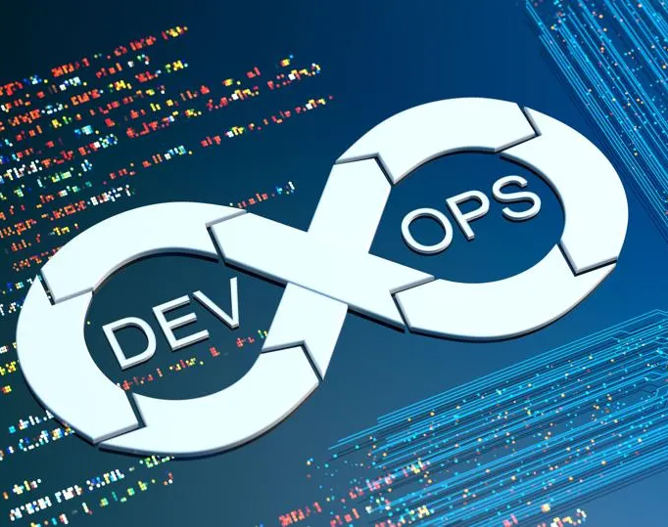
Embracing DevOps Practices
Here, we delve into the methodologies and practices that underpinned our DevOps approach. From Continuous Integration/Continuous Deployment (CI/CD) to Infrastructure as Code (IaC) and automation, we discuss how these practices were integrated into our workflow to enhance efficiency, quality, and collaboration.

Slide 3

Defining Scope and Structure
This phase offers a comprehensive overview of the project, outlining its scope, constraints, and key challenges faced. We also delve into the team structure, elucidating the roles and responsibilities of each team member, which played a crucial role in shaping the project's success.

Slide 4

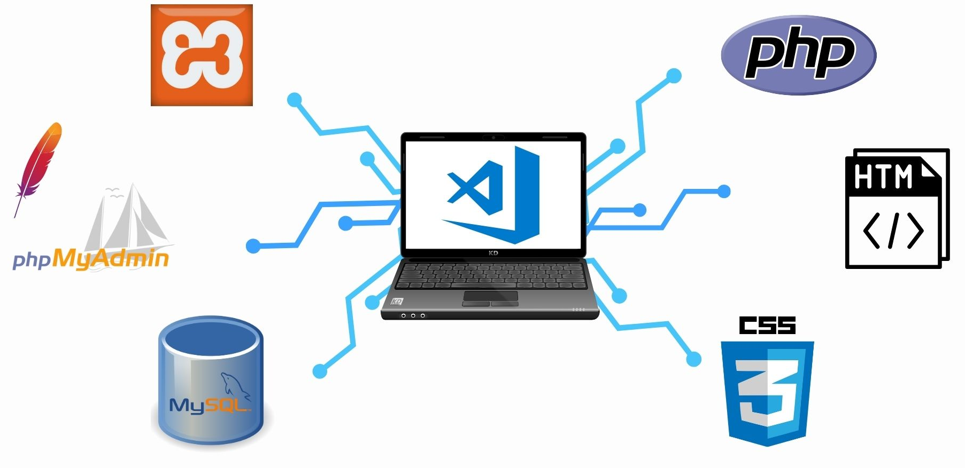
Application Architecture
Streamlining Collaboration

Slide 5





Documentation
Click me
Click me
Click me
Click me

Slide 6
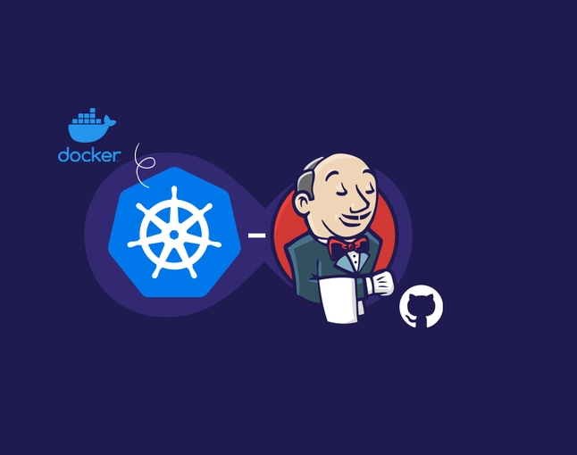
Automating Deployment Pipelines
Here, we dive into our deployment process, showcasing how changes were deployed on Minikube to a staging and production environments with minimal manual intervention. We highlight the automation implemented in our deployment pipelines, which improved efficiency, reliability, and consistency across environments.

Slide 7
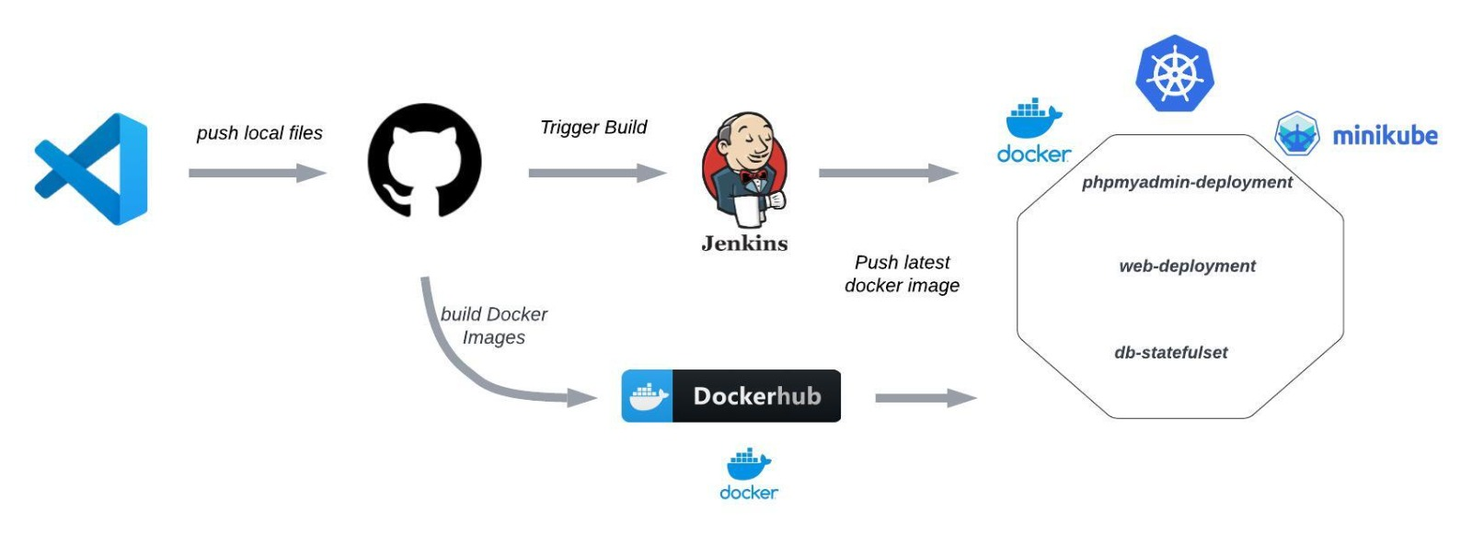
Application Architecture
Application Architecture

Slide 8

Ensuring System Health
In this phase, we discuss our monitoring and logging strategies, which were instrumental in tracking the health and performance of our system in real-time. We present key metrics and indicators used to measure the success of our DevOps practices, demonstrating our commitment to continuous improvement.

Slide 9
Documentation
Click me
Click me
Click me
Click me

Slide 10
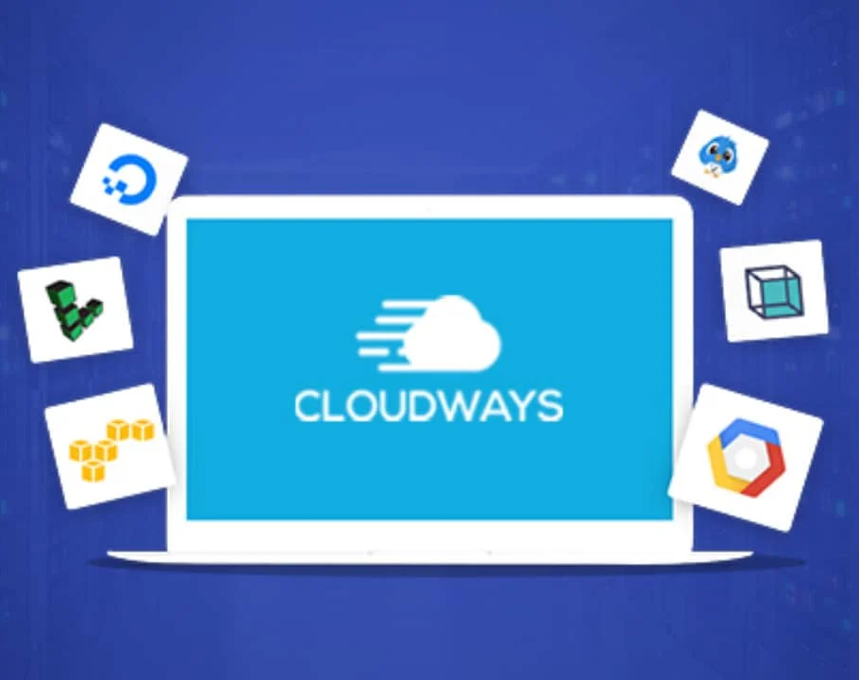
Automating Deployment Pipelines
Here, we dive into our deployment process, showcasing how changes were deployed on cloudways. We highlight the automation implemented in our deployment pipelines, which improved efficiency, reliability, and consistency across environments.

Slide 11
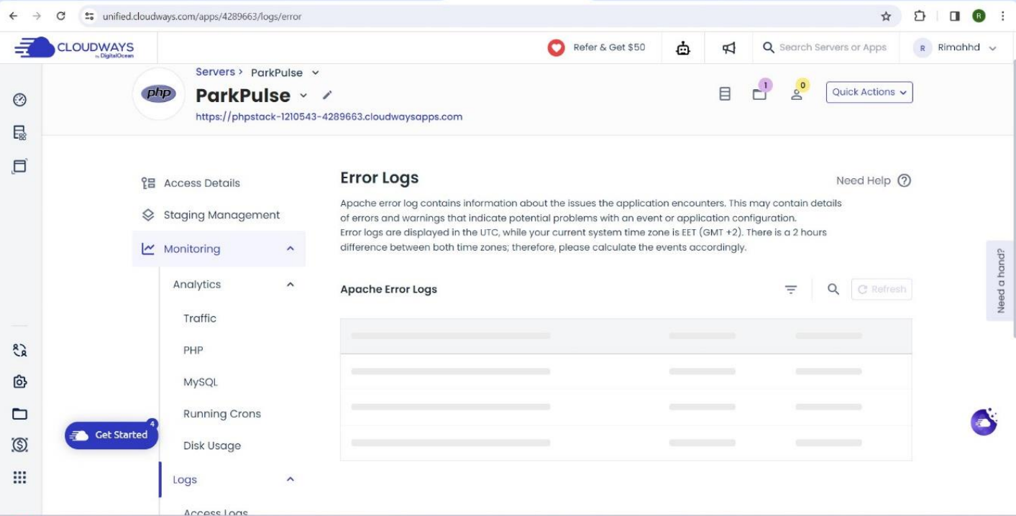

Slide 12
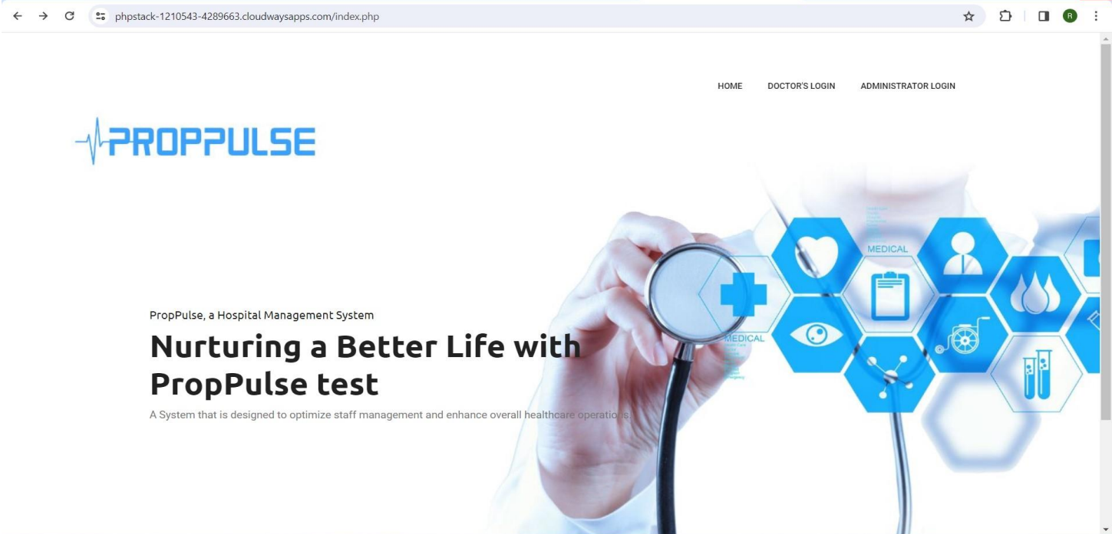

Slide 13

Looking Back and Moving Forward
Finally, we conclude the presentation by summarizing the key points discussed and reiterating the significance of our DevOps journey. We express gratitude to the audience for their attention and invite questions, fostering further discussion and collaboration as we continue to evolve and innovate in the realm of DevOps.

Slide 14

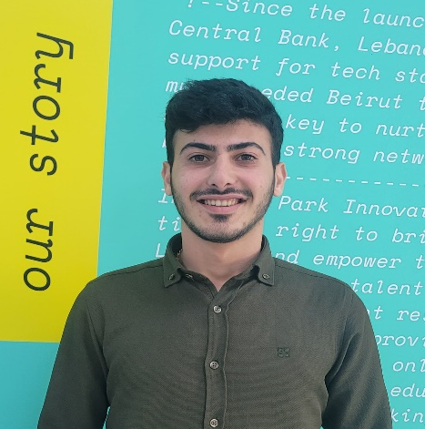


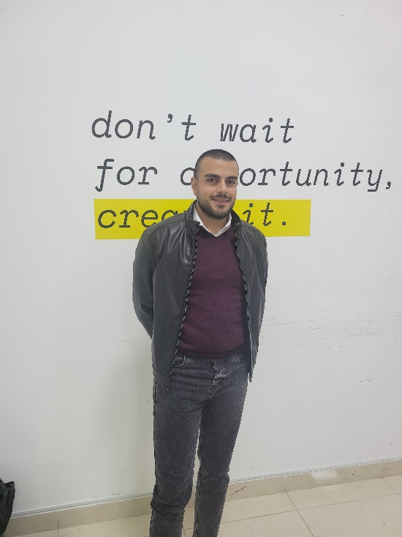

Thank you !
ParkPulse
Rimah Housamedine
Jalal Soboh
Aleen Zeidan
Bahaa Abou Shakra
Raafat El Halabi

